Slide 1
Software Testing Course’s Code: CSE 453 Test Design Techniques – Equivalent Class Partition (ECP)

Slide 2
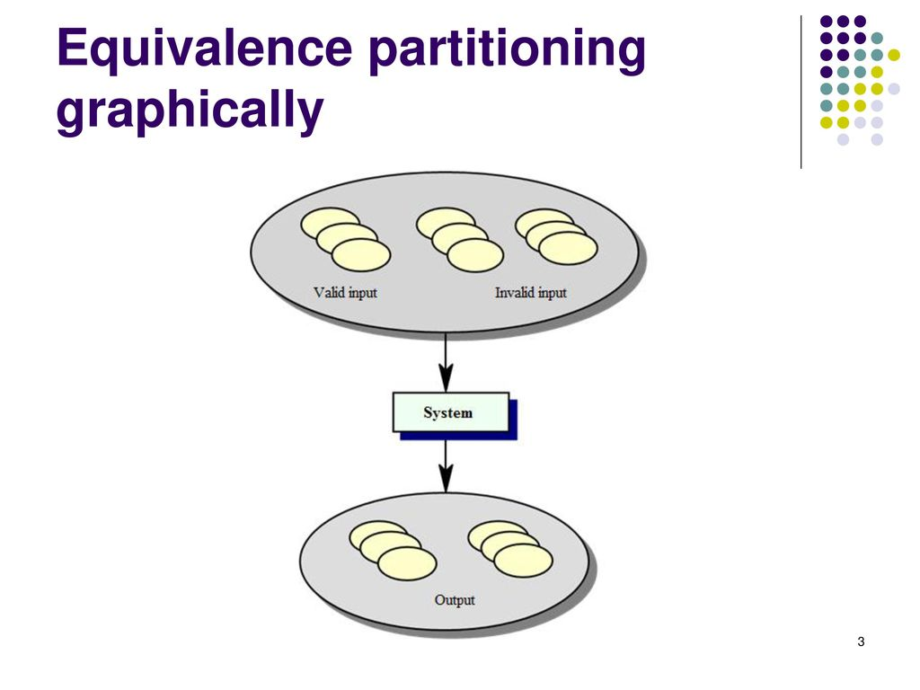
Equivalence partitioning
Divides the input data of a software unit into partitions of equivalent data (groups of similar data) from which test cases can be derived
reduce the number of test cases
Also Known as Equivalence Class Partitioning

Slide 3
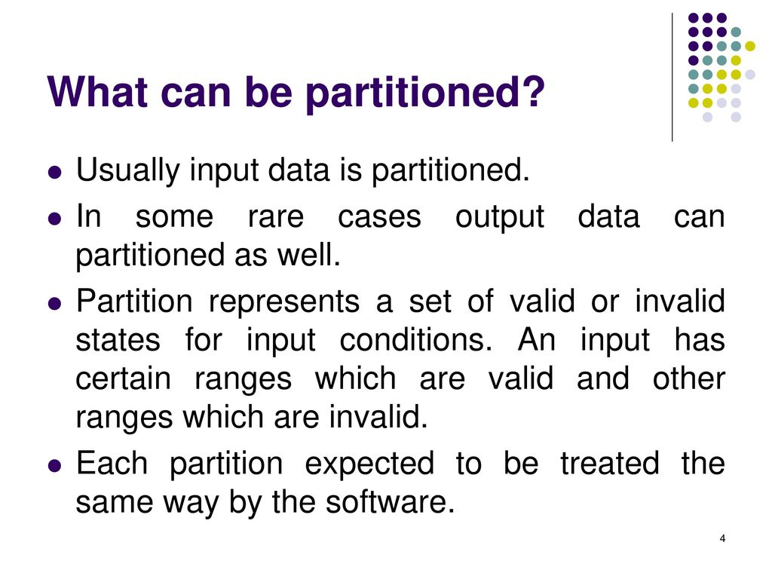
Equivalence partitioning

Slide 4
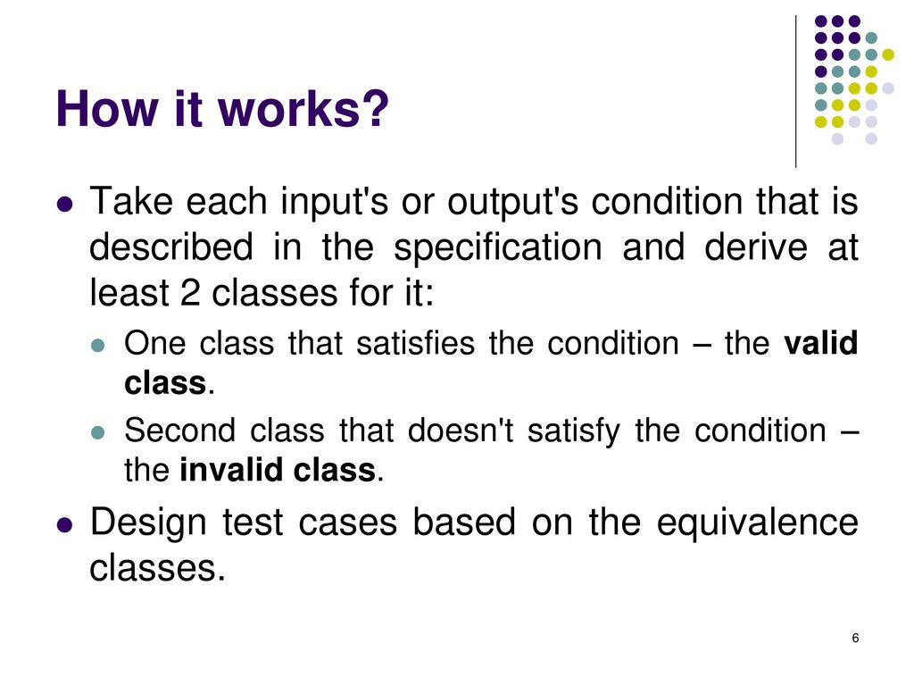
Equivalence partitioning

Slide 5
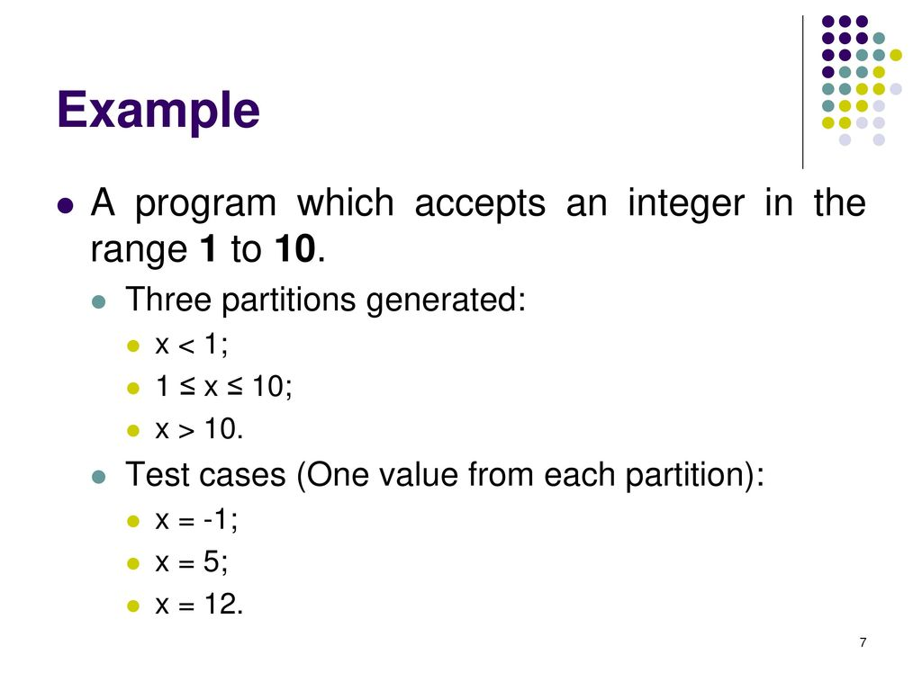
Equivalence partitioning

Slide 6
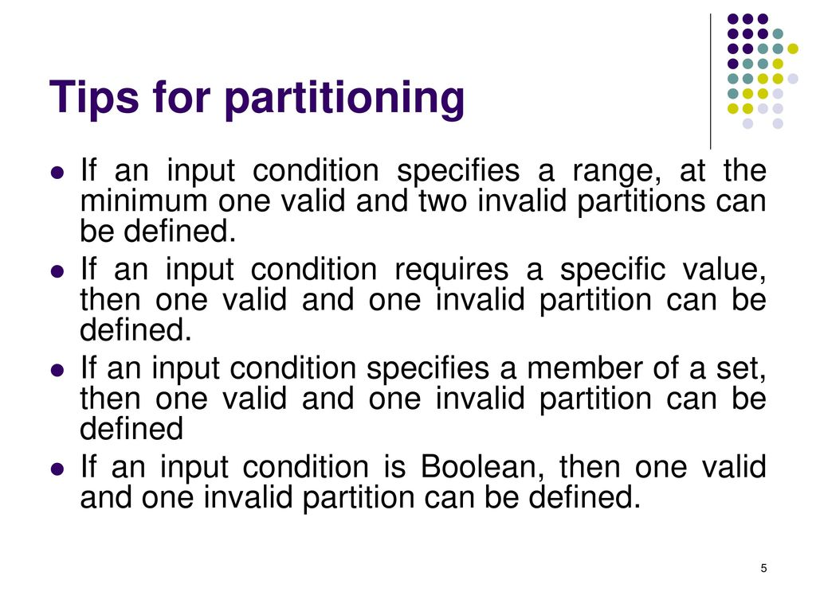
Equivalence partitioning

Slide 7
Examples on Equivalence partitioning
Let's check our requirement: we need to develop a program that tells us whether a year is a leap year or not.

Slide 8
Examples on Equivalence partitioning
So, there are three conditions
If we divide the year by 4, and the remainder is zero, then it is a leap year
However, we have some exceptions: if the year can also be divided by one hundred exactly, then it is not a leap year.
However, these years can still be leap, if they are divisible by four hundred.

Slide 9
Examples on Equivalence partitioning
So, how do we test this?
The first thing we should do is to break the problem into smaller partitions, or classes.
Each partition represents a different case that has to be tested.
Here, different cases represent different inputs

Slide 10
Examples on Equivalence partitioning
So, Let’s keep thinking about partitions

Slide 11
Examples on Equivalence partitioning
So, Let’s keep thinking about partitions

Slide 12
Examples on Equivalence partitioning
For now, we only thought about our program identifying leap years.
But we should also make sure that it can identify years that are **not** leap years.

Slide 13
Examples on Equivalence partitioning
The first one is years divisible by four, and not divisible by one hundred.
As concrete examples, years like 2016, or 2020, fall into this partition.
Second partition is years divisible by four, divisible by one hundred, which would make this year a non- leap year.
But if it is also divisible by four hundred, then it turns back into a leap year.
A concrete example is the year 2000.
Third case represents if the number is not divisible by four, the year is not a leap year.
For example, 2015, and 2017.
Finally, in fourth case, a year that is divisible by 4, divisible by one hundred, but not divisible by four hundred, is not a leap year.
Examples are 1500 and 1900

Slide 14
Examples on Equivalence partitioning

Slide 15
Examples on Equivalence partitioning

Slide 16
Examples on Equivalence partitioning
Clearly, it would be impractical to test all the possible inputs for this partition.
However, all of them are equivalent.

Slide 17
Examples on Equivalence partitioning
One good is tip is to actually name your test methods after the partition.
1st Partition

Slide 18
Examples on Equivalence partitioning
2nd Partition
3rd Partition

Slide 19
Examples on Equivalence partitioning
4th Partition

